Slide 1
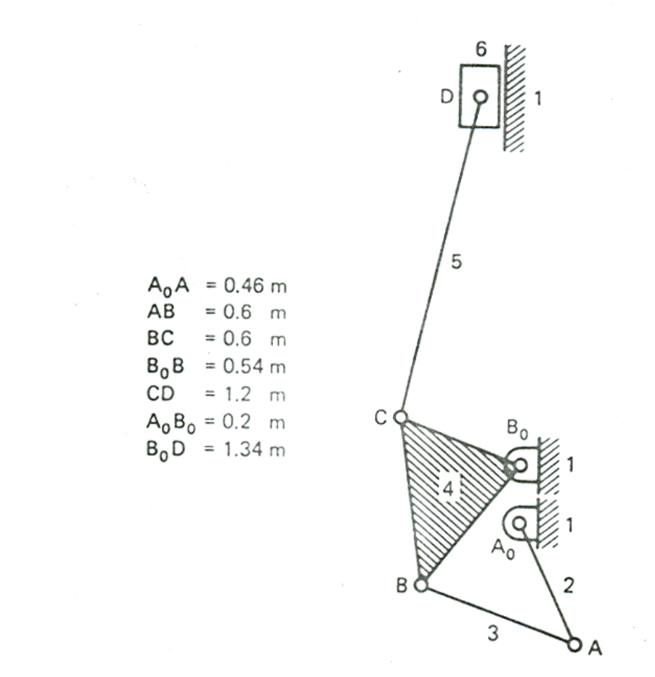
Method of IC’s : Problem 1
Find the ratio V_{D}/ω₂

Slide 2
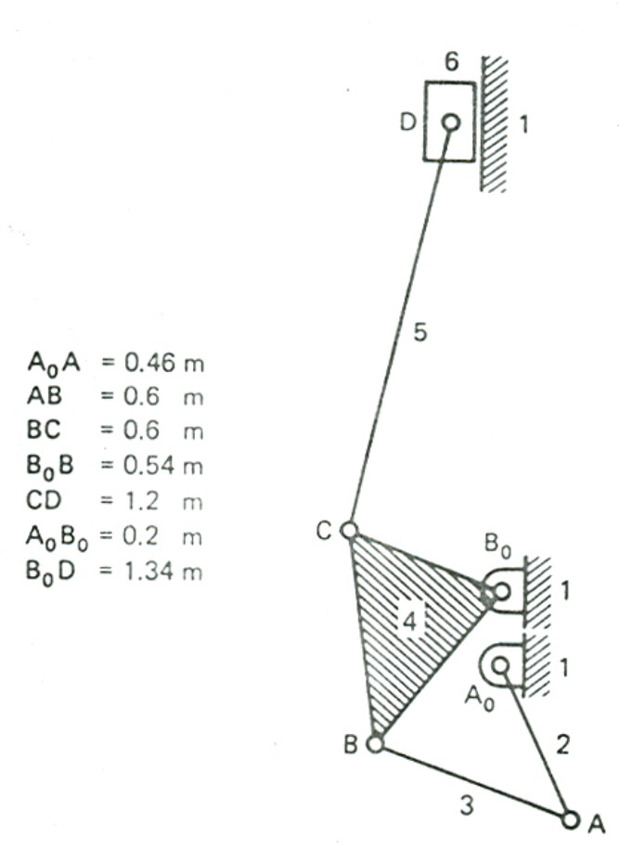
Solution 1 : Finding IC’s
1
V_{D} is associated with link 6, ω₂ with link2. Hence 26 is the critical IC.Note that all lines of type mn-16 will simply be horizontal lines passing through mn.
2
6
3
5
4
16
56
45
46
14
36
13
26
12
34
23

Slide 3
Solution 1 : Finding velocities
1
V_{A2} = ω₂ A₀A is known in magnitude (in terms of ω₂ ) and direction (normal to A₀A).
2
6
3
5
4
16
56
Note that all points in a translating body have the same absolute velocity (radius of curvature of the line of translation being infinite).
Which is why the absolute velocity of 26 needs only to be translated to point D
45
46
14
36
26
13
12
34
23
No scaling or projecting is required unlike revolute joints. If the constructions are correct the velocity vector will automatically come in the correct orientation

Slide 4
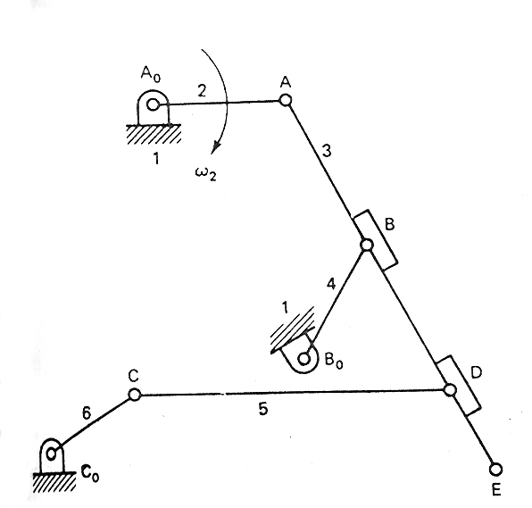
Method of IC’s : Problem 2
A₀A₀=1.188
AB =1.375
AD =2.750
A₀B =1.125
CD =2.625
C₀C =0.938
DE =0.750
A₀B₀=2.560
A₀C₀=3.040
B₀C₀=2.320
Find the velocity of the points E and C and the angular velocity of link 6, given ω₂ = 10 rad/sec cw

Slide 5
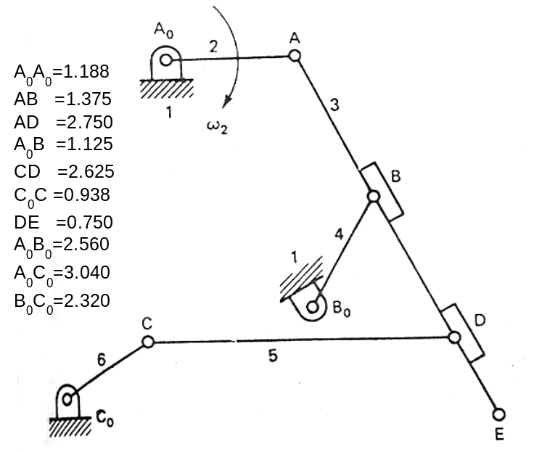
Solution 2 : Finding IC’s
1
C is on link 6 while E is on link 3. ω₂ is associated with link 2. Hence 16 & 26 and 13 & 23 are critical ICs.
2
6
3
5
4
12
23
34
14
56
35
16

Slide 6
Solution 2 : Finding IC’s
1
C is on link 6 while E is on link 3. ω₂ is associated with link 2. Hence 16 & 26 and 13 & 23 are critical ICs.
2
6
3
5
4
13
12
23
V_{A}
34
14
56
35
V_{E}
16

Slide 7
Solution 2 : Finding IC’s
1
26 needs to be found now.
To find 26, 36 is needed.
2
6
3
5
4
13
12
23
34
36
14
56
35
16
26

Slide 8
Solution 2 : Finding IC’s
1
26 needs to be found now.
To find 26, 36 is needed.
2
6
3
5
4
13
12
23
V_{A}
34
36
14
56
35
16
V_{C}
26

Slide 9
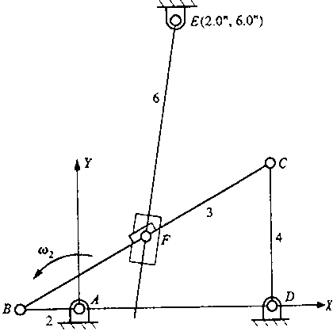
Method of IC’s : Problem 3
Find ω₂/ω₆

Slide 10
Solution 3 : Finding IC’s
1
2
6
3
5
16
4
Locate simple I.C.’s first
34
35
56
23
12
14
26 is the critical I.C. To find 26, 36 is needed.
To find 36, 13 is needed. 13 can be found from initial data

Slide 11
Solution 3 : Finding IC’s
1
2
6
3
5
16
4
34
35
36
56
26
13
23
12
14

Slide 12
Solution 3 : Finding velocities
1
2
6
3
5
16
4
ω₆=V₂₆/L₁₆₋₂₆
34
35
36
56
26
13
23
12
14
ω₂xAB

Slide 13
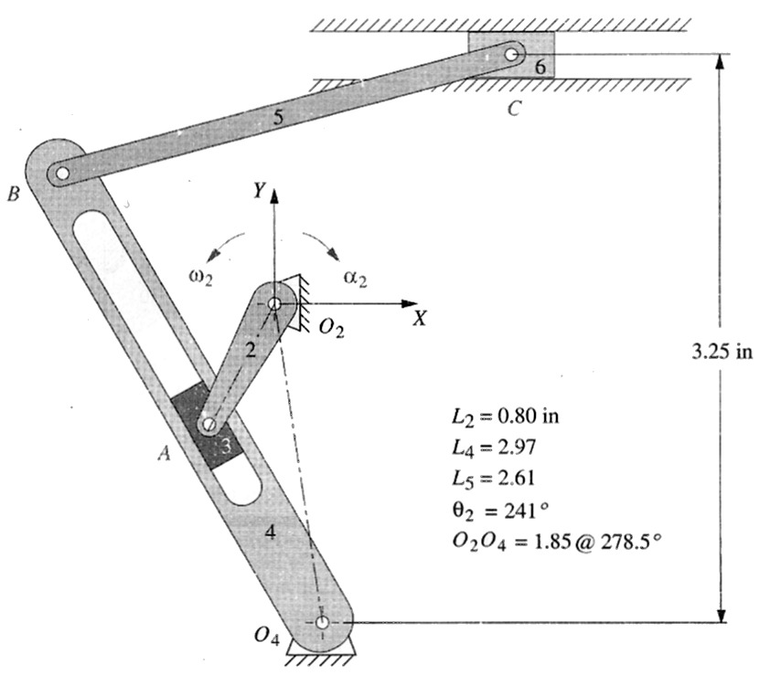
  Find V_{A}, V_{B}, V_{C} and the sliding velocity of link 3 w.r.t link 4 for the position shown if ω₂ = 40 rad/min as shown. Use the method of IC’s to find the velocities.

Slide 14
6
  Find the simple IC’s
1
5
2
4
3
16
56
54
12
23
34
14

Slide 15
6
  Critical IC’s are 12, 23, 13 , …
1
5
2
4
3
16
56
54
12
23
34
14
V_{A}
13
V_{A3A4}

Slide 16
6
  Critical IC’s are … 24, …
1
5
2
4
3
16
V_{B}
56
54
12
23
24
34
14
V_{A}
13
V_{A3A4}

Slide 17
6
  Critical IC’s are … 26
1
5
2
4
3
16
V_{B}
56
54
46
V_{C}
12
23
24
26
34
14
V_{A}
13
V_{A3A4}

